Slide 1
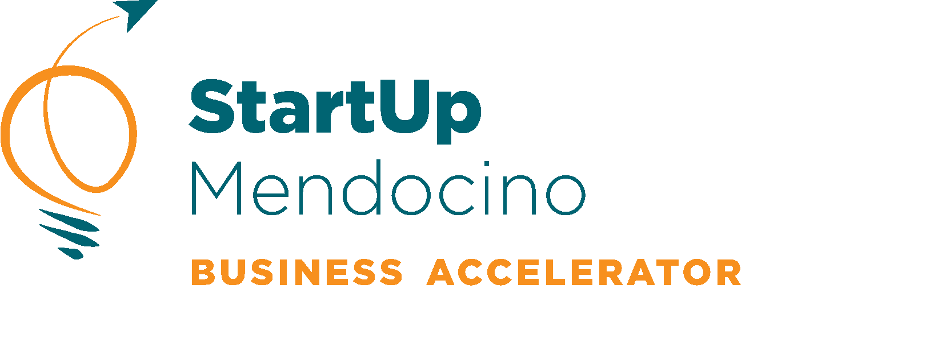
2024
Sustainable Business: Creating a Foundation that is Built to Last

Slide 2
Agenda
Personal Objectives
Vision
Business Plan
Licensing, Permits and Insurance
Next Steps
Worksheet Review
“It takes as much energy to wish, as it does to plan.” — Eleanor Roosevelt
WESTCENTER.ORG/STARTUP-MENDO

Slide 3
Ground Rules
By remembering to be confidential, this will help you and your group members create a relationship based on trust and honesty.
Listen to your trainer and group members feedback, while using the tools you have been given to fully evaluate the value of the feedback for your business.
Communication will be delivered with care. Creating space for others will only enhance our listening skills and make us better verbal communicators.
WESTCENTER.ORG/STARTUP-MENDO

Slide 4
The Big Assumption
“Just because you know how to do the work of the business, means you know how to do the business of that work”
-M.Gerber, The EMyth Revisited.”
WESTCENTER.ORG/STARTUP-MENDO

Slide 5
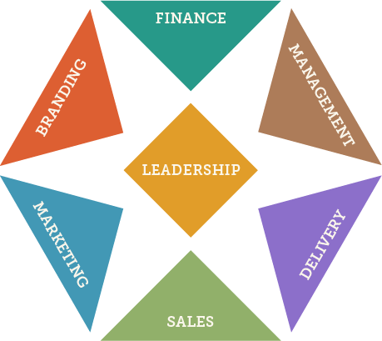
Business Functions Structure for a business that works
Organizing your business with structure will help you grow in a way that doesn’t consume you. This will become the blueprint you use to systemize the workflow, hiring, growth strategy and management.
What is your Vision?
By creating your vision first, you will be able to develop your infrastructure relevant for your needs. Some areas may grow at different speeds than others.
Leadership First
Leadership is the conduit for the systemic connections throughought your business. It helps individuals, work flow and departments connect when they should and need to. Making leadership a priority, will enhance everything else you may still be doing in the business, nonetheless grow it.
WESTCENTER.ORG/STARTUP-MENDO

Slide 6
Personal Objectives
Aristotle said, “People are goal seeking animals. Their lives only have meaning if they are reaching out and striving for meaningful goals.” Whether you have set goals intentionally or not, we all have goals. Some of us may think we don’t have goals, but we do.
Leadership Means Life, then Business
While you may not always be able to prioritize your time, you must think of yourself first, then you can build a business that supports that.
Goals and Planning
Dreaming of your goals is only the first step towards achieving your goals. The next crucial step is then planning; which takes forecasting, organizing, self management systems and consistency.
WESTCENTER.ORG/STARTUP-MENDO

Slide 7
Business Vision Turning Your Ideas into Action
Documenting a vision provides a sense of purpose and direction towards the future, inspiration for you and your employees, transfers ownership and becomes a basis for decision making, planning, and business development activities.
Design First, Build Second
Creating your business first will ensure you build something that achieves what you want. Do you remember what you first dreamt about when opening your business?
Your Commitment becomes The Commitment
Building the business of your dreams is only possible if others can help. Your dreams are probably bigger than what you can do by yourself. By creating your vision first, others can be part of helping you create what you want.
WESTCENTER.ORG/STARTUP-MENDO

Slide 8
What Next? Three Years From Today
When beginning your exploration, think of the the end result you desire. For many, speaking and writing your vision is the present tense helps remove any current barriers that may keep you from your truest vision. It is important to remember not to worry about how you are going to create your vision but focus on what your vision is.
WESTCENTER.ORG/STARTUP-MENDO

Slide 9
Discover Your Vision
Your vision should be a documented vision for what your business looks like when it is “done”. It should be written for 3-5 years in the future, and only contain what you want it to look like, not how.
How will you use it?
Your vision will be the blueprint for your business plan. Using it to guide all planning and decision making. When a vision has a comprehensive outline of what the business will look like, tangible and intangible, when it is done, a leader can always know they are making the right decisions for the business and themselves.
https://www.synergybusinesscoaching.com/blog/this-is-why-you-arent-getting-their-attention
WESTCENTER.ORG/STARTUP-MENDO

Slide 10
Business Plan
A business plan is a formal, written document that outlines the plan for achieving a vision with a time frame for specific milestones.
WESTCENTER.ORG/STARTUP-MENDO

Slide 11
Business Plan Planning the 7 Business Functions
A business plan that works is heart centered; being driven by the vision the owner has. Keeping in mind that no plan is precise, your best predictions and knowledge being applied will be as much science and fact as art and perception.
Create a Framework that Accommodates Change
A plan that is too full or aggressive generally doesn’t work. Create space for the unknown and if you find yourself moving faster, reassess how much more you want to do or not.
Organize What you Know, What you Don’t and Who Can Help
Don’t hold yourself back by what you don’t know. Organize the areas you don’t know first, so you can find the help you need as you document the things you do. In the end there are never exacts in business.
WESTCENTER.ORG/STARTUP-MENDO

Slide 12
Detailed Planning
Make it easy. It doesn’t have to be hard. Use what you’ve already got. Build on it. Include the elements that make the most sense for your business. Don’t load it up unnecessarily for the sake of volume.
It would adapt easily to change. It would have a clear purpose and be appropriate for the result it’s intended to produce. It would be balanced in terms of how it addresses the different areas of the business. It would have a clear monitoring and follow-up mechanism. And it would have “energy” and reflect the passion you feel for your business.
Use common sense. Don’t be swayed by any “logic” and don’t include any “plan” that doesn’t make sense to you. Can you see that the business plan that always works only works because of you?
Quantify your efforts in a habitual way, recalibrate if needed. Get comfortable looking at your year in four quarterly chunks or 90 day increments. Through running a variance report of what you have done and haven’t, you can make changes to your plan in a strategic way.
WESTCENTER.ORG/STARTUP-MENDO

Slide 13
Self Management is a Process, Not a Destination
WESTCENTER.ORG/STARTUP-MENDO

Slide 14
Self Management
What is Self Management?
Doing what is important vs what is interesting
Following Through: Doing what you say, when you say it
Being focused, saying no or parking lot the right things
Modeling responsibility for your people
Take The Quiz
WESTCENTER.ORG/STARTUP-MENDO

Slide 15
Organization and Planning Yourself
Task manage monthly, weekly and daily
Prioritize
Stay focused
Just say no
Stop letting your email check you
Limit your availability through different communication channels
Don’t overbook
Set Routines
Set Deadlines
Divide and Conquer big jobs
WESTCENTER.ORG/STARTUP-MENDO

Slide 16
Business Structure
Your business structure affects how much you pay in taxes, your ability to raise money, the paperwork you need to file, and your personal liability.
You'll need to choose a business structure before you register your business with the state.
Choose carefully. While you may convert to a different business structure in the future, something that you can use as long as possible will prove to be the most cost effective.
"You must keep your mind on the objective, not on the obstacle." --William Randolph
WESTCENTER.ORG/STARTUP-MENDO

Slide 17
Sole Proprietorship
A sole proprietorship is easy to form and gives you complete control of your business. You're automatically considered to be a sole proprietorship if you do business activities but don't register as any other kind of business.
Sole proprietorships do not produce a separate business entity. This means your business assets and liabilities are not separate from your personal assets and liabilities. You can be held personally liable for the debts and obligations of the business. Sole proprietors are still able to get a trademark. It can also be hard to raise money because you can't sell stock, and banks are hesitant to lend to sole proprietorships.
Sole proprietorships can be a good choice for low-risk businesses and owners who want to test their business idea before forming a more formal business.
WESTCENTER.ORG/STARTUP-MENDO

Slide 18
Partnership
Partnerships are the simplest structure for two or more people to own a business together. There are two common kinds of partnerships: limited partnerships (LP) and limited liability partnerships (LLP).
Limited partnerships have only one general partner with unlimited liability, and all other partners have limited liability. The partners with limited liability also tend to have limited control over the company, which is documented in a partnership agreement. Profits are passed through to personal tax returns, and the general partner — the partner without limited liability — must also pay self-employment taxes.
Limited liability partnerships are similar to limited partnerships but give limited liability to every owner. An LLP protects each partner from debts against the partnership, they won't be responsible for the actions of other partners.
Partnerships can be a good choice for businesses with multiple owners, professional groups (like attorneys), and groups who want to test their business idea before forming a more formal business.
WESTCENTER.ORG/STARTUP-MENDO

Slide 19
Limited Liability Corp(LLC)
An LLC lets you take advantage of the benefits of both the corporation and partnership business structures.
LLCs protect you from personal liability in most instances, your personal assets — like your vehicle, house, and savings accounts — won't be at risk in case your LLC faces bankruptcy or lawsuits.
Profits and losses can get passed through to your personal income without facing corporate taxes. However, members of an LLC are considered self-employed and must pay self-employment tax contributions towards Medicare and Social Security.
LLCs can have a limited life in many states. When a member joins or leaves an LLC, some states may require the LLC to be dissolved and re-formed with new membership — unless there's already an agreement in place within the LLC for buying, selling, and transferring ownership.
LLCs can be a good choice for medium- or higher-risk businesses, owners with significant personal assets they want protected, and owners who want to pay a lower tax rate than they would with a corporation.
WESTCENTER.ORG/STARTUP-MENDO

Slide 20
Corporation
C corp
A corporation, sometimes called a C corp, is a legal entity that's separate from its owners. Corporations can make a profit, be taxed, and can be held legally liable.
S corp
An S corporation, sometimes called an S corp, is a special type of corporation that's designed to avoid the double taxation drawback of regular C corps. S corps allow profits, and some losses, to be passed through directly to owners' personal income without ever being subject to corporate tax rates.
B corp
A benefit corporation, sometimes called a B corp, is a for-profit corporation recognized by a majority of U.S. states. B corps are different from C corps in purpose, accountability, and transparency, but aren't different in how they're taxed. B corps are driven by both mission and profit. Shareholders hold the company accountable to produce some sort of public benefit in addition to a financial profit. Some states require B corps to submit annual benefit reports that demonstrate their contribution to the public good.
Nonprofit corporation
Nonprofit corporations are organized to do charity, education, religious, literary, or scientific work. Because their work benefits the public, nonprofits can receive tax-exempt status, meaning they don't pay state or federal income taxes on any profits it makes.
WESTCENTER.ORG/STARTUP-MENDO

Slide 21
Cooperative
A cooperative is a business or organization owned by and operated for the benefit of those using its services. Profits and earnings generated by the cooperative are distributed among the members, also known as user-owners. Typically, an elected board of directors and officers run the cooperative while regular members have voting power to control the direction of the cooperative. Members can become part of the cooperative by purchasing shares, though the amount of shares they hold does not affect the weight of their vote.
WESTCENTER.ORG/STARTUP-MENDO

Slide 22
Taxes
The business structure you set up will determine what type of taxes and how you pay those taxes.
There are five general areas of tax that most businesses will pay.
"Taxation is the price which civilized communities pay for the opportunity of remaining civilized.“
- Albert Bushnell Hart
WESTCENTER.ORG/STARTUP-MENDO

Slide 23
Income Tax
All businesses except partnerships must file an annual income tax return. Partnerships file an information return. The form you use depends on how your business is organized.
The federal income tax is a pay-as-you-go tax. You must pay the tax as you earn or receive income during the year. An employee usually has income tax withheld from his or her pay. If you do not pay your tax through withholding, or do not pay enough tax that way, you might have to pay estimated tax. If you are not required to make estimated tax payments, you may pay any tax due when you file your return.
WESTCENTER.ORG/STARTUP-MENDO

Slide 24
Self-Employment Tax
Self-employment tax (SE tax) is a social security and Medicare tax primarily for individuals who work for themselves. Your payments of SE tax contribute to your coverage under the social security system. Social security coverage provides you with retirement benefits, disability benefits, survivor benefits, and hospital insurance (Medicare) benefits.
WESTCENTER.ORG/STARTUP-MENDO

Slide 25
Employment Taxes
When you have employees, you as the employer have certain employment tax responsibilities that you must pay and forms you must file. Employment taxes include the following:
Social security and Medicare taxes
Federal income tax withholding
Federal unemployment (FUTA) tax
WESTCENTER.ORG/STARTUP-MENDO

Slide 26
Excise Tax
An excise tax is a tax imposed on a specific good or activity. Excise taxes are commonly levied on cigarettes, alcoholic beverages, soda, gasoline, insurance premiums, amusement activities, enviornmental impacts, some transportation and betting,
WESTCENTER.ORG/STARTUP-MENDO

Slide 27
Licenses and Permits
Need a Permit or License?
All businesses in Mendocino County, whether in the city limits or unincorporated areas will need licenses to operate in their region, industry and with the public depending on what you are doing and how you are doing it.
WESTCENTER.ORG/STARTUP-MENDO

Slide 28
What Do I Need for Mendocino?
Treasurer Tax - Collector
Business License
TOT Registration
Agriculture
Device Registration
Pesticide Use
Planning and Building Services
Use Permit
Variance
General Plan Amendment
Building Permit
Certificate of Compliance
Coastal Development Permit
Boundary Line Adjustment
Subdivision
Environmental Health Consumer Protection:
Facility Permit to Operate
Community Event Permit
Temporary Food Vendor Permit
Swimming Pool/Spa Permit
Body Art Permit
Body Art Practitioner
Cottage Food Permits
Septic Tank Replacement Permit
Water Well Permit
UST Repair or Construction Permit
UST Removal Permit
Transportation
Encroachment Permits
Transportation Permits
Street Closure Permits
Animal Care Services
Pet License
Marriage License
Air Quality Management District
Burn Permit
Renovation and Demolition Notification
Grading Permit
Diesel Engine Permit
Mendocino County Sherriff
ABC Permits
Concealed Carry Permit
Explosives Permit
Itinerant Permit
WESTCENTER.ORG/STARTUP-MENDO

Slide 29
State and Federal Licenses
According to former University of South Carolina Law Professor William Quirk's Law Review article, “Nature of a Business License Tax,” the foundation for the business license tax was laid when the General Assembly passed an act in 1872 to provide for a general license law.
California
Resellers Certificate: If you make three or more sales in a 12 month period.
Federal
The federal government regulates advertising, labor, environmental impact, privacy and health and safety. Check to see if you need further licensees to operate if your business falls or is connected to one of these.
WESTCENTER.ORG/STARTUP-MENDO

Slide 30
What Is Insurance?
Insurance is a contract, represented by a policy, in which an individual or entity receives financial protection or reimbursement against losses from an insurance company. The company pools clients' risks to make payments more affordable for the insured.
Insurance policies are used to assist against the risk of financial losses, both big and small, that may result from damage to the insured property, or from liability for damage or injury caused to a third party.
WESTCENTER.ORG/STARTUP-MENDO

Slide 31
What Insurance Do I Need?
When purchasing business insurance, it’s important to obtain the right amount. Be sure that your business is neither over insured nor underinsured. To help you decide the amount of property insurance you need, refer to your company’s assets list. You can buy property insurance on the basis of the property’s actual value (the replacement cost minus depreciation) or its replacement value (the cost of replacing the item without deducting for depreciation). An agent and insurance company familiar with the risks typically involved with your type of operation can help you decide on a reasonable amount of liability.
Property and Renters Insurance
Liability Insurance
Business Vehicle Insurance
Workers Comp Insurance
WESTCENTER.ORG/STARTUP-MENDO

Slide 32
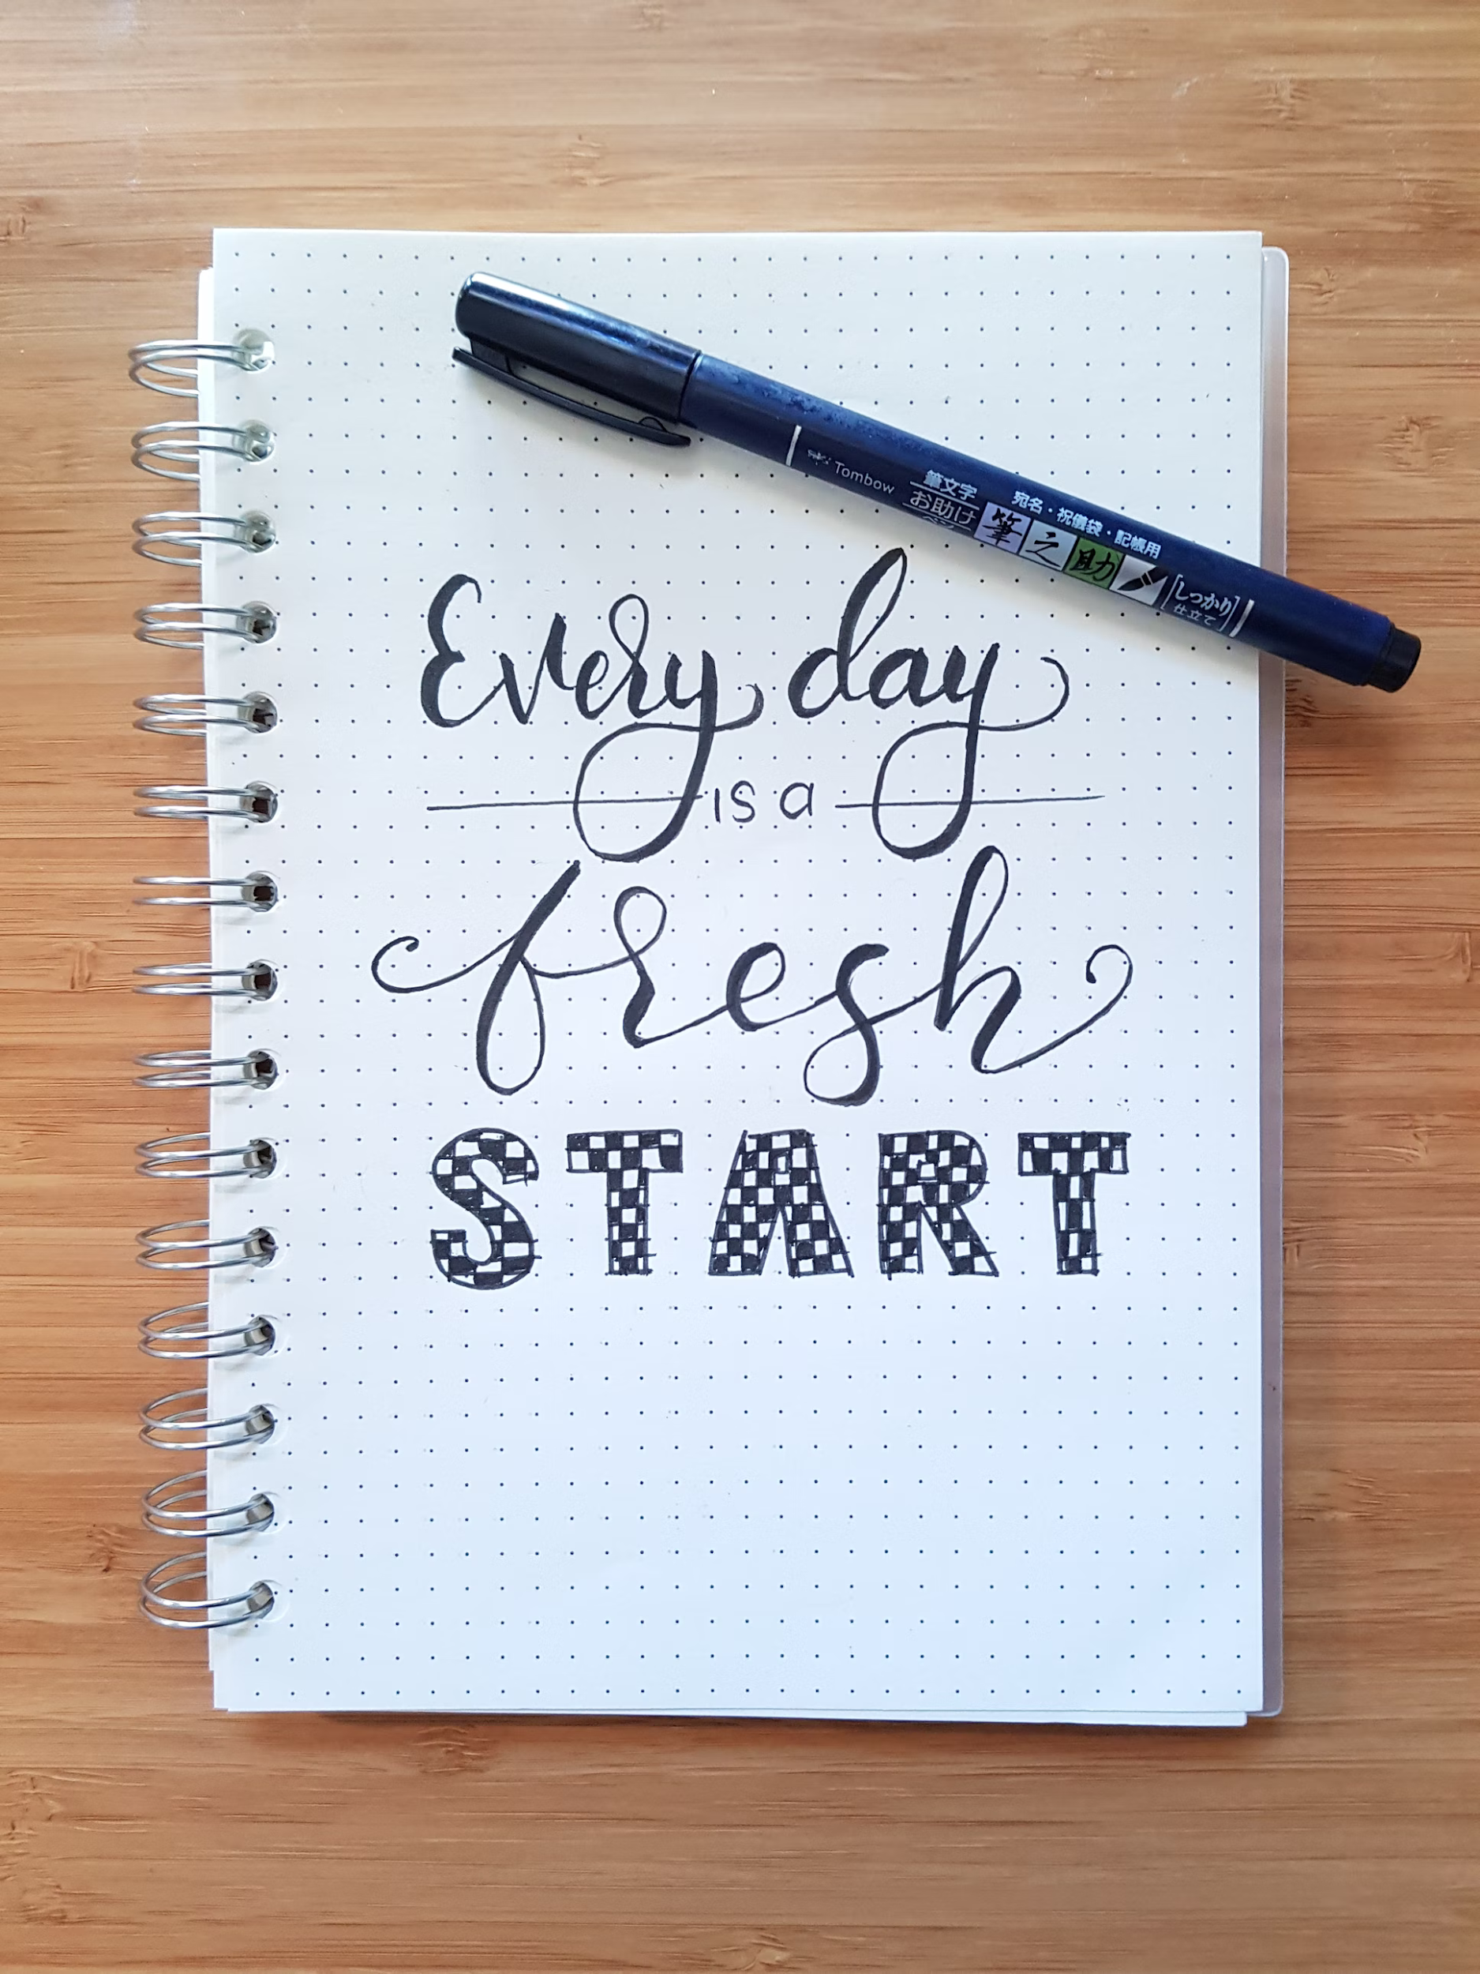
Next Steps
Personal Objectives Worksheet
Business Plan
7 Ingredients of a Successful Business
Review and Confirm Business Structure and Insurance Needs
Take the Self Management Quiz
WESTCENTER.ORG/STARTUP-MENDO

Slide 33
Worksheet Review
WESTCENTER.ORG/STARTUP-MENDO

Slide 34
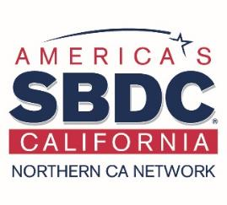
THANK YOU FOR BEING PART OF
2024
WESTCENTER.ORG/STARTUP-MENDO

